Slide 1
In-Person Workshop of the School of Drafting Regulations (Radiation Safety Programme)
(23 January to 3 February 2023)
Plans for drafting new or revise existing regulations
Country: …………….
Notes:
Good

Slide 2
A- Regulatory Body
Name:
Date of establishment:
Assigned responsibilities (e.g. radiation safety, nuclear safety, nuclear security, safeguards, etc.):
Legal instruments that the RB is authorized to elaborate and issue: (e.g. regulations, guides, codes, standards, etc.)
Repeat the slide for each regulatory body if there is more than one

Slide 3
B- Existing Regulations
Please list those regulations already issued and enforced in the country:
Issued by | Date of Issuance | Title | No.
 |  |  | 1
 |  |  | 2
 |  |  | 3
Add more slides if necessary

Slide 4
C- Regulations planned/in drafting
Please list any regulations under drafting/planned to be drafted:
To be issued by | Planned date of Issuance | Title | No.
 |  |  | 1
 |  |  | 2
 |  |  | 3
Add more slides if necessary

Slide 5
D- Regulations
Please describe (preferably using a diagram) the process to draft/revise regulations
Repeat the slide for each regulatory body if there is more than one

Slide 6
E- Action Plan
Please indicate briefly a realistically achievable action plan leading to publication of the regulation(s) in drafting/revision with the assistance of the IAEA’s School of Drafting Regulations
Expected timeframe | Responsible(s) Party(ies) | Action

Slide 7

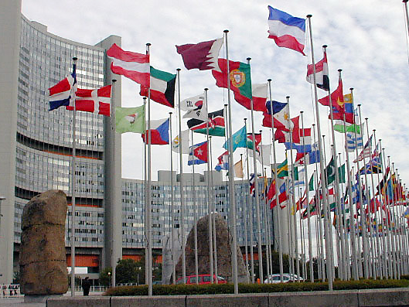
Technical cooperation: delivering results for peace and
development
IAEA http://www.iaea.org/
TC: http://www-tc.iaea.org

